Slide 1
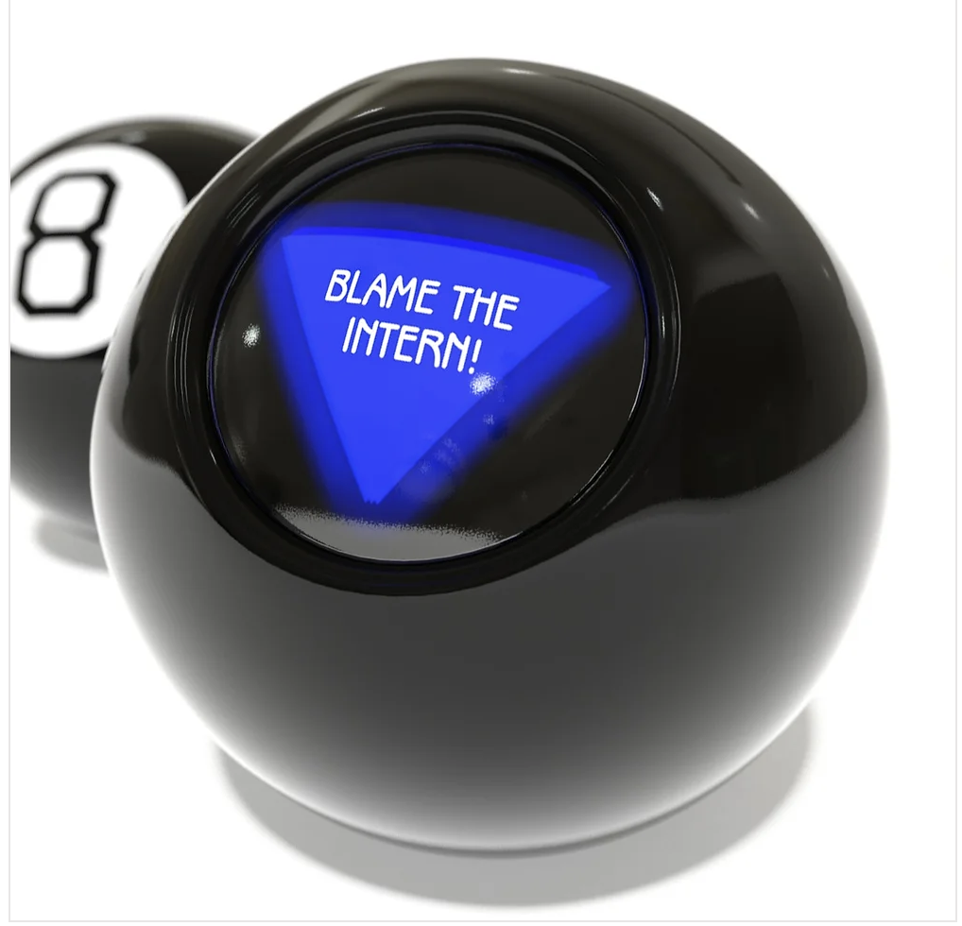
Magically Magic 8 Ball
Kaiti Holcomb & Imani Ford
The Magically Magic 8 Ball is unique because fortune tellers are not the only ones who can use it! The everyday person can use this program to predict what their future looks like with a simple question. You cannot say that every Magic 8 Ball is like this one.

